Slide 1
Critical Design Review
Project Title: Imaging with EIT System
Product Title: RF Impedance Vision
Team Name: Wavegen Warriors
Sponsor: Andy Goldstein
Notes:
Dante

Slide 2


Team Members: Dante Ausonio
Primary Roles:
Team Lead
System Architect
UI Development
Backup Roles:
Logistics Manager
Software Engineering

Slide 3


Team Members: Graham Snyder
Primary Roles:
Budget/Logistics Manager
Hardware Enclosure, RF Design
Backup Roles:
Customer Manager, Team Lead
Analog-Debugging, UI Development, Power Management

Slide 4

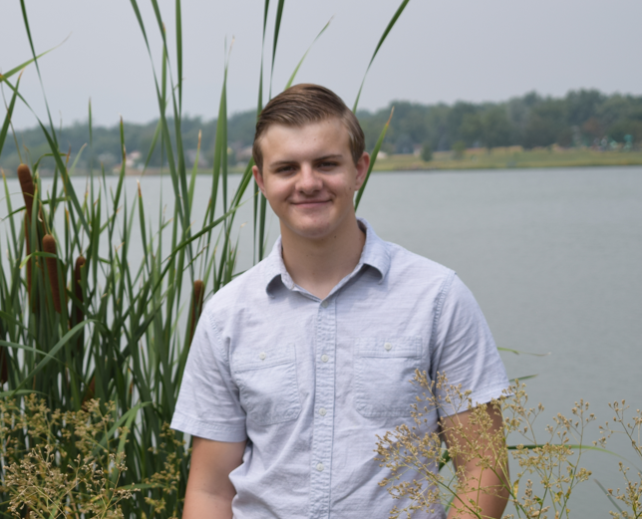
Team Members: Gavin Unrue
Primary Roles:
Software Engineer
Morale Manager
Backup Roles:
PCB Design
Assignment Schedule Manager
Embedded Systems Engineer

Slide 5


Team Members: Peter Braza
Primary Roles:
Embedded Systems Engineer
Customer Manager
Backup Roles:
Power Management
Testing
Analog Debugging
Project Schedule Manager

Slide 6

Team Members: Ahmed Khan
Primary Roles:
PCB Design
Analog Debugging
Communications Manager
Backup roles:
RF Design
System Architect
Morale Manager

Slide 7

Team Members: Gustavo Sanchez Sanchez Jr.
Primary Roles:
Project and Assignments Schedule Manager
Test Engineering
Power Management
Backup roles:
Communications Manager
Team Lead
Analog Debugging
Software Engineering

Slide 8
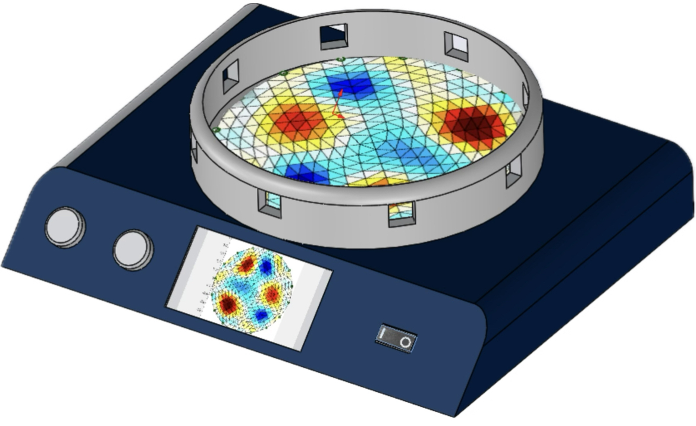
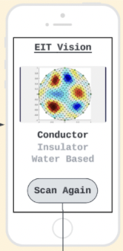
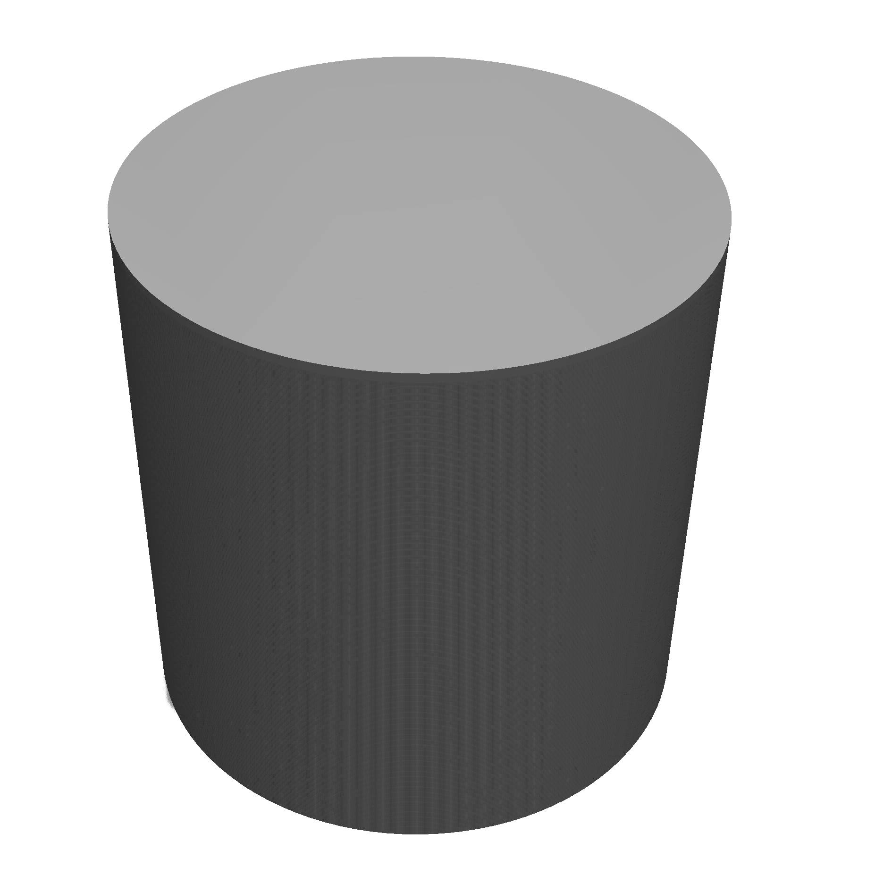
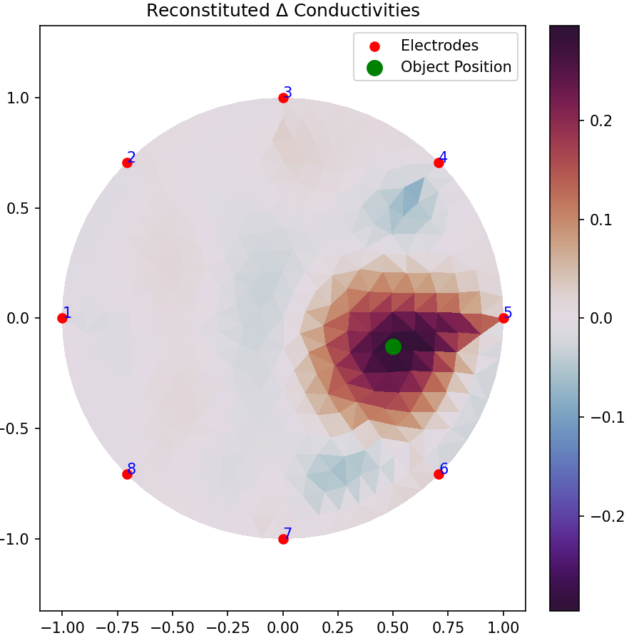

Product Overview
The RF Impedance Vision is a one foot diameter sensor platform designed to image the encircled region using RF transceivers placed along the circumference of the platform. These sensors transmit and receive RF signals which are used to generate a top-down 2D image of the region and measure the electrical properties of objects placed in the sensing region. A conductor, insulator, and water-based material will be tested.
This project is a research exploration into determining if RF EIT is a viable technology.
+
Notes:
Dante

Slide 9
Product Behaviors
Turn on device.
Calibrate.
Select a cylindrical object and place within sensing platform.
Run scan.
See top-down 2D image results of object.
View object classification results (conductor, insulator, water based).
Notes:
Graham

Slide 10
Primary Marketing Requirements
EIT system displays top-down 2D image of item placed in scanning area.
EIT system can classify object’s material for user.
Results are given within 30 seconds from pressing start button.
Device works for a conductor, insulator, and water-based cylindrical object.
Easy to understand setup instructions and output results to the user.
Notes:
Gavin

Slide 11
Primary Engineering Requirements
System uses RF to detect difference between empty space and objects, and classify objects based on signal disruption.
EIT system does not take longer than 30 seconds to produce one image.
System has minimum of six sensor nodes.
Sensors scan one at a time sequentially.
System has a calibration feature to account for environment noise
Notes:
Gavin

Slide 12
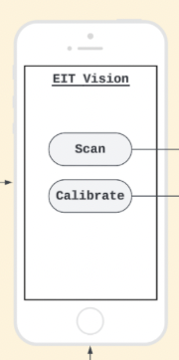
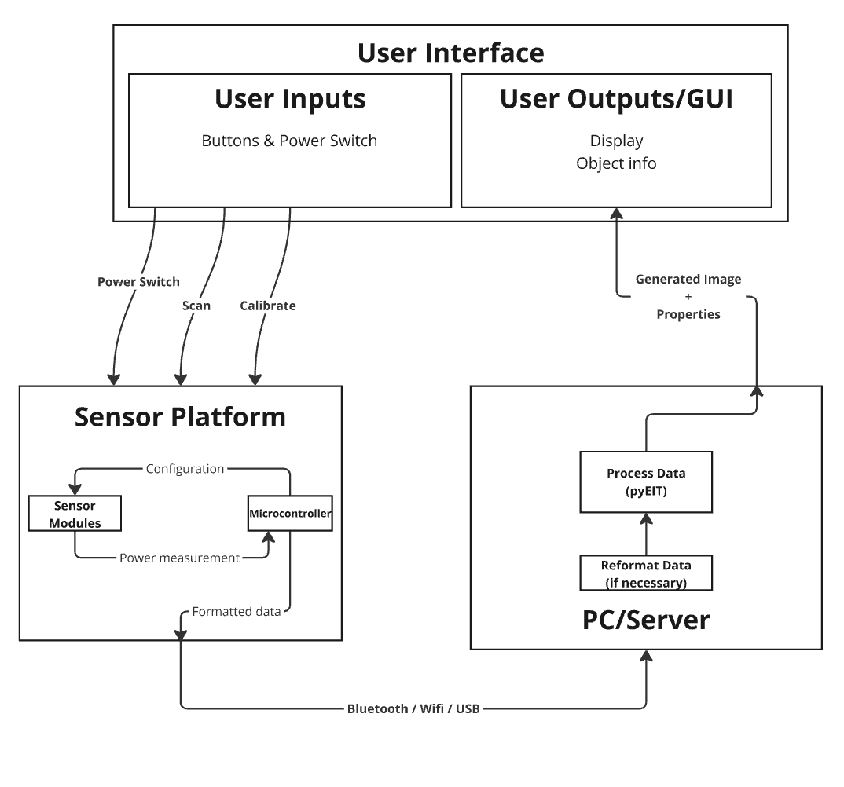

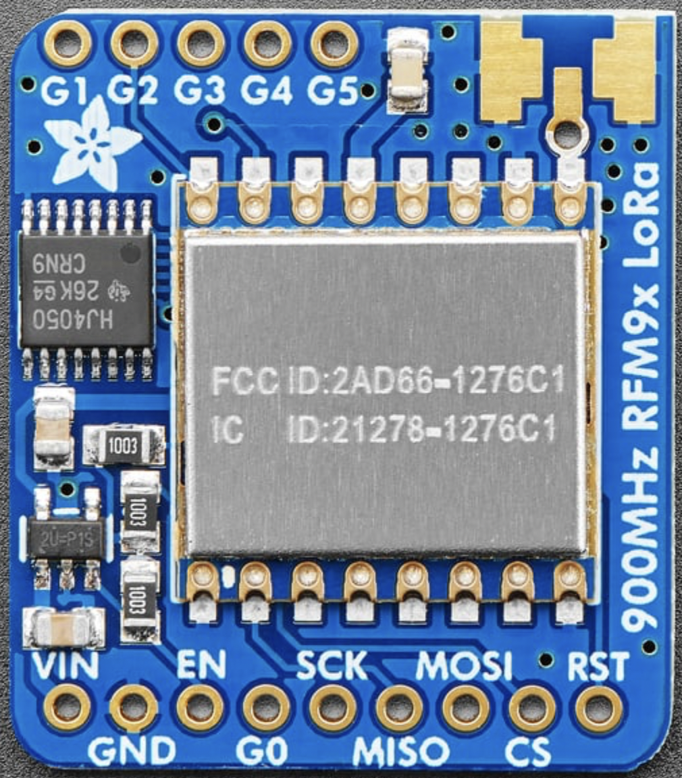
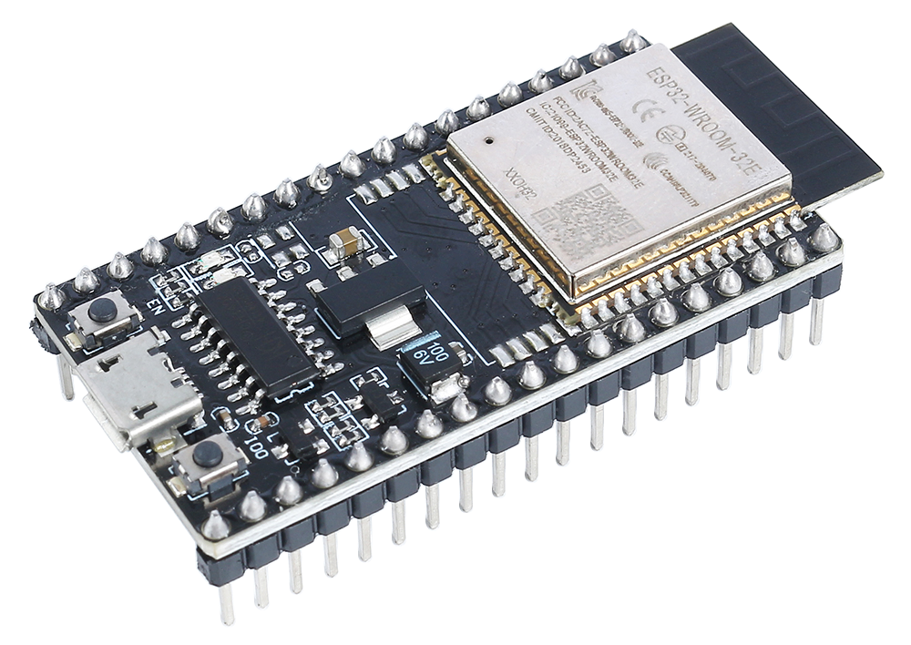

Overall Product Design
User Interface
Sensing Platform
PC/Server
x8
USB
Notes:
Ahmed

Slide 13
Technology Choices
Microcontroller:
ESP32
8x LoRa Modules (RFM95)
SPI communication protocol
Transmitting and receiving at 915 MHz
RadioHead library for LoRa communication
pyEIT Library for Imaging Data
pySerial for connecting LoRa output data stored on ESP32 to pyEIT script Input
x8 Sensors
Notes:
Peter

Slide 14
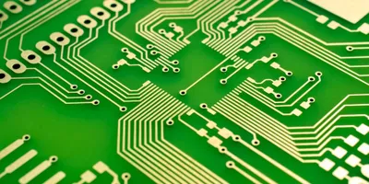
Non-Commodity Technology
The non-commodity technology includes:
Custom imaging Python code using pyEIT Library
Custom formatting code with pySerial for ESP32 to pyEIT pipeline
PCB supporting eight LoRa sensors, and ESP32
UI software to display results on screen
Hardware enclosure (3D Printing and ITLL Machine Shop)
Notes:
Graham

Slide 15
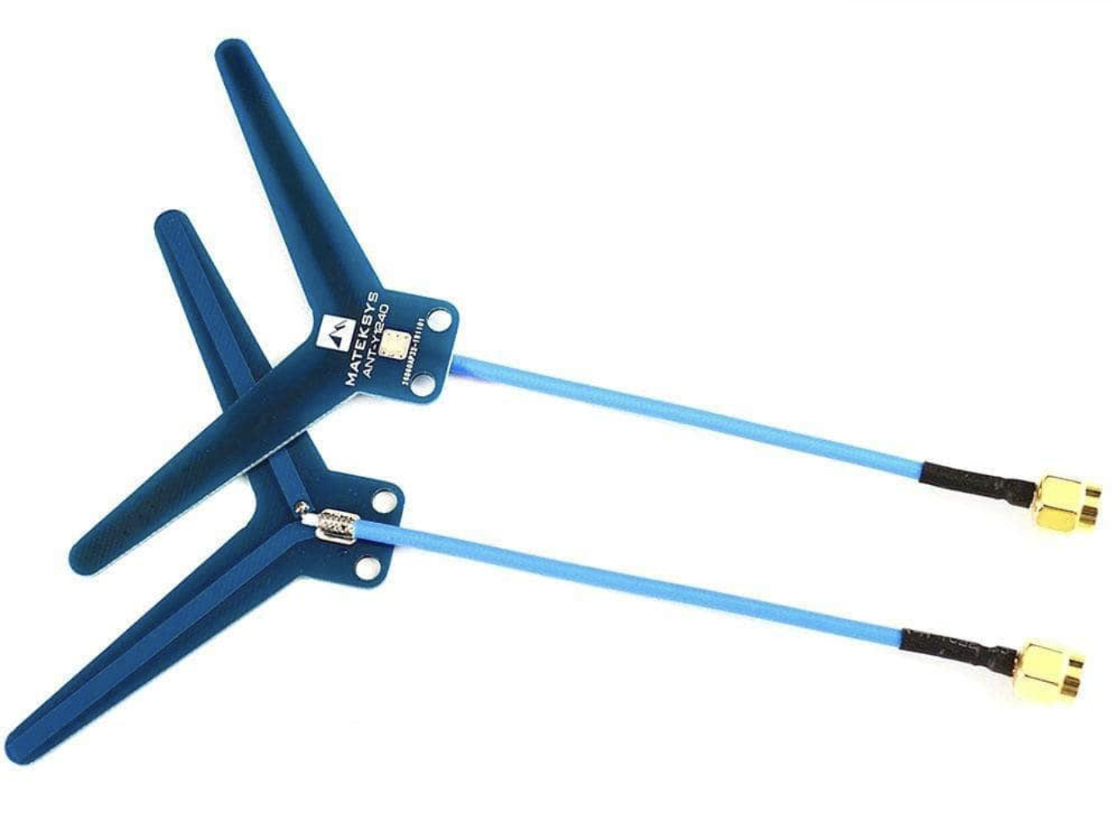
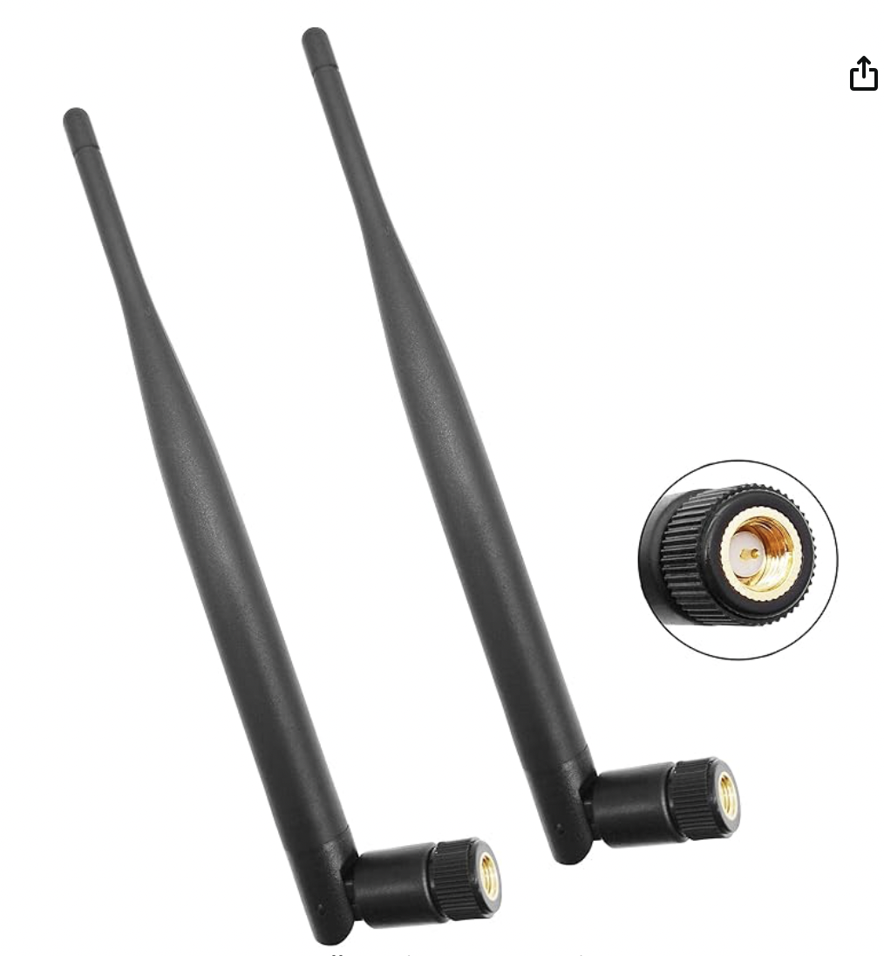
LoRa Sensors and Antennas
RFM95W LoRa sensors numbers:
300 kbps rate
10 Hz for full transmission and converting RSSI value
About -80 to -90 dBm smallest possible readings: large range
Minimum packet size, one bit character of letter “h”
-50 dBm value with no objects and sensors one foot apart
Hard-coded amplifier gain settings
Antennas:
Currently using SMA dipole antennas
Switching to omnidirectional whip antennas (low risk)
Notes:
Graham

Slide 16
User Interface
For now:
2 buttons on the sensing device, and a computer connected to the device.
One button will calibrate the device. The computer will output a calibrated image, or a message saying ‘calibrated’.
The other button will take generate an image, and display that on the screen.
Back up plan:
No real user interface. Just run the code from the terminal and pull up images from the output files.
We would have to walk people through this process.
Shows off underlying technology, not ideal, but UI is the least significant priority.
Stretch goal to use an app for the UI.
Communicate between phone and modules using bluetooth.
Notes:
Dante

Slide 17
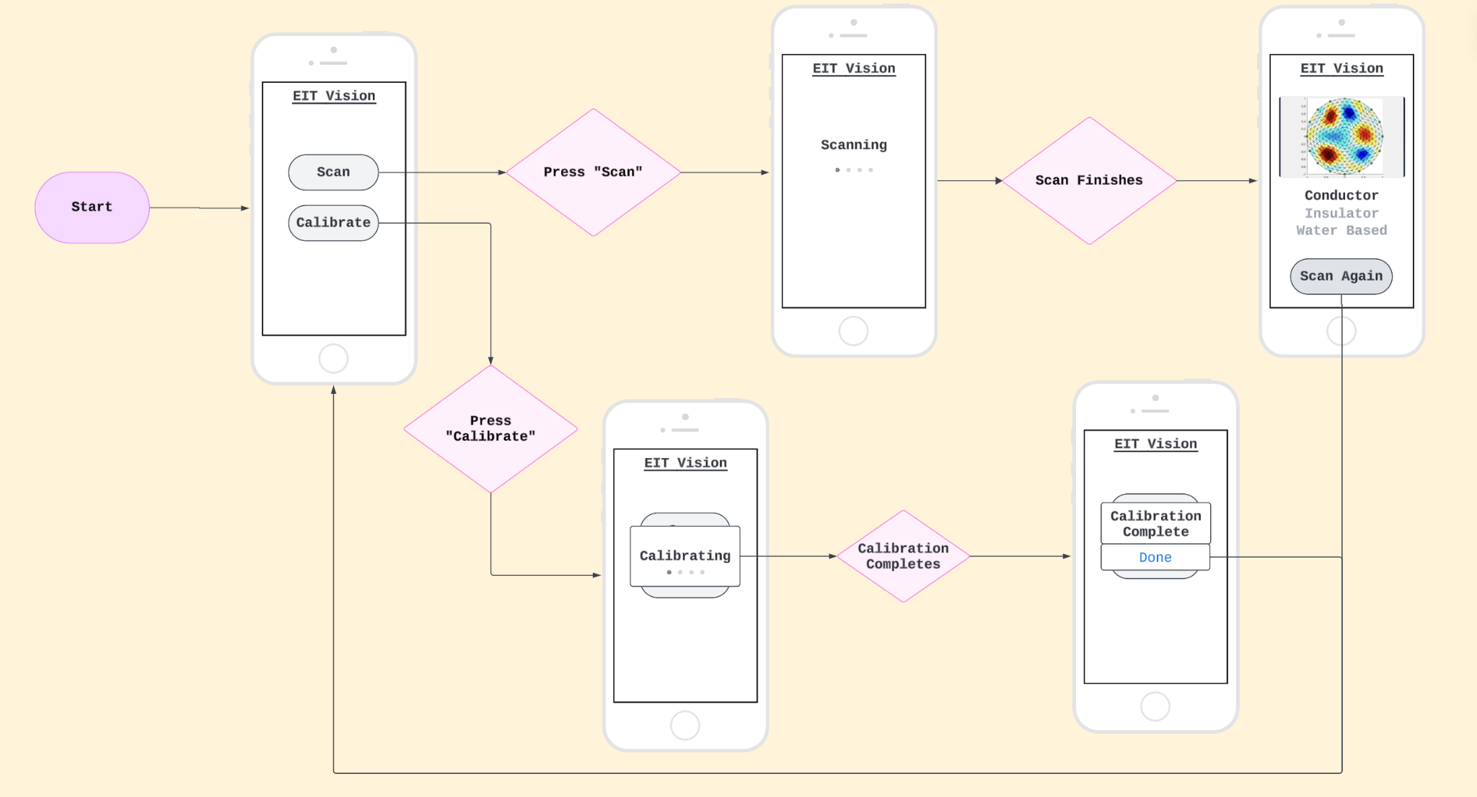
UI Mockup
Notes:
Dante

Slide 18
Technical Performance
RSSI can be read by LoRa to a resolution of 1 dBm.
RSSI varies between different objects and different distances.
Conductors cause readings of < -50 dBm
Insulators cause readings of >= -50 dBm
PyEIT can image using eight LoRa sensors in a ring.
PyEIT can produce accurate and useful top-down images
Object location with minimum 4 quadrants of location precision available
Object conductivity (outside of certain thresholds)
Notes:
Ahmed

Slide 19
Power Budget
120 V RMS (wall outlet power)
Supplies 5v power adapter for sensor platform
Power Consumption:
8x RFM9x 5v LoRa modules* 100mW → 0.8W transmission
→Estimate 1W total including LoRa sub-controllers
Microcontroller 100mA max total*5v → 0.5W
UI + illumination → 0.5W
Total: 2W → Allocate at least 3W minimum for safe overhead for entire platform/power supply rating
Standard phone chargers can easily reach 10-12W and will function nicely for our application as they provide 5v over usb
Monitor/computer for data visualization has self-contained power supply/battery and is powered from the 120v wall supply
Notes:
Ahmed

Slide 20
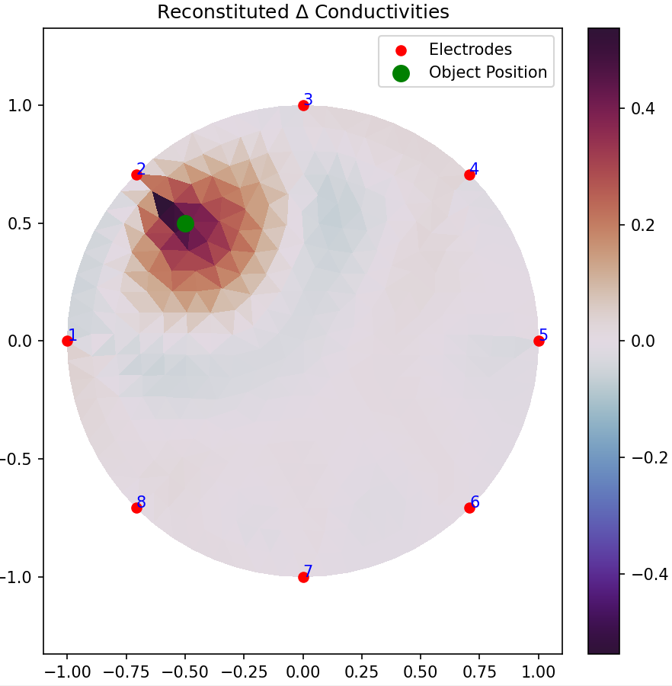
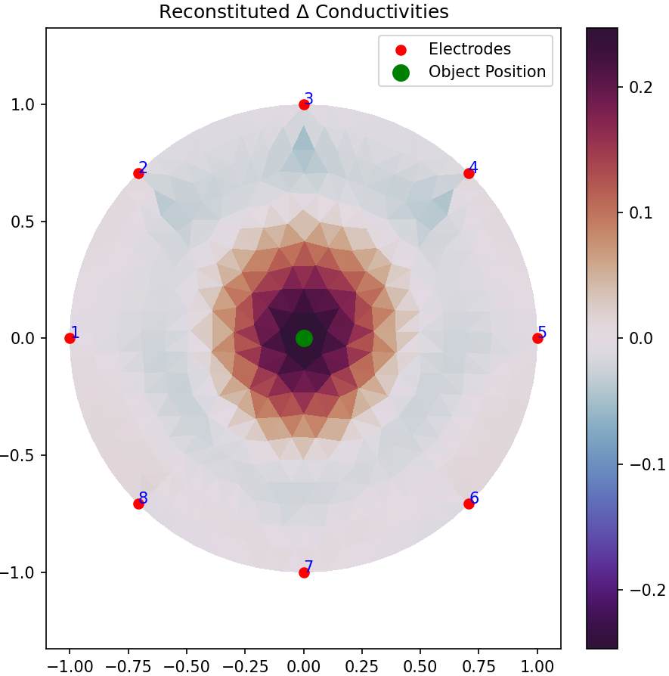
Acceptance Tests (Software)
Current Simulated Data Imaging Results
Notes:
Gus

Slide 21
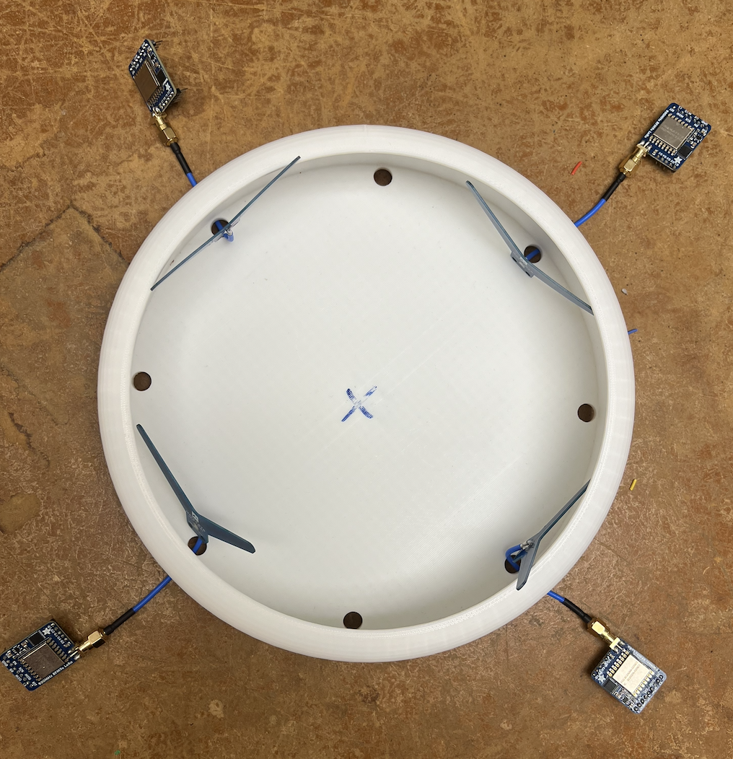
Integration/Acceptance Tests
Are we able to print sensor readings passed to pySerial from LoRa modules?
Can we get an image using that sensor data?
Are these images consistently repeatable?
Does the object accurately display in four different quadrants?
Was the image created in 30 seconds or less after starting the device?
Does it accurately provide correct material results?
Notes:
Peter

Slide 22
Design History/Impact of Tests (Software)
Started with open source library EIDORS.
Back propagate conductivity but heavy dependency of other resources for our implementation.
Switched to pyEIT due to higher amount of documentation and less demand of resources.
Figured out how to do imaging with 16 sensors.
Finalized to working with eight sensors for final product.
Notes:
Gus

Slide 23
Design History/Impact of Tests (Hardware)
Discovered when testing the two sensor PoC setup:
Jump in the receiver gain when the signal intensity exceeds -45dBm.
Temporary fix by reducing the overall transmit intensity to below the cutoff.
Antenna directionality and external interference.
Will switch to omnidirectional whip antennas.
RF Foam insulation to reduce reflections
Choose sampling duration to reduce effects of people standing near the sensors
SPI communication bus made with hookup wires can occasionally disconnect when moving the test setup → area of improvement going forward.
Arduino serial print causes problems when called frequently - should be avoided when transmitting.
Were able to verify the noise floor using the scope, capstone lab has low noise in our frequency range.
Notes:
Ahmed

Slide 24
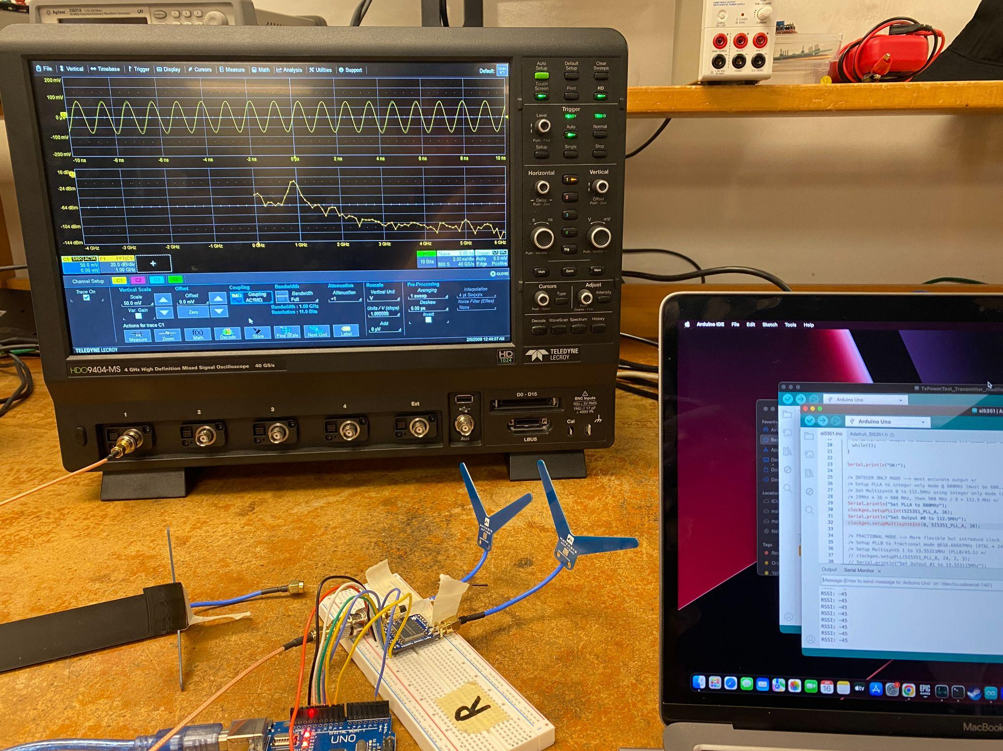
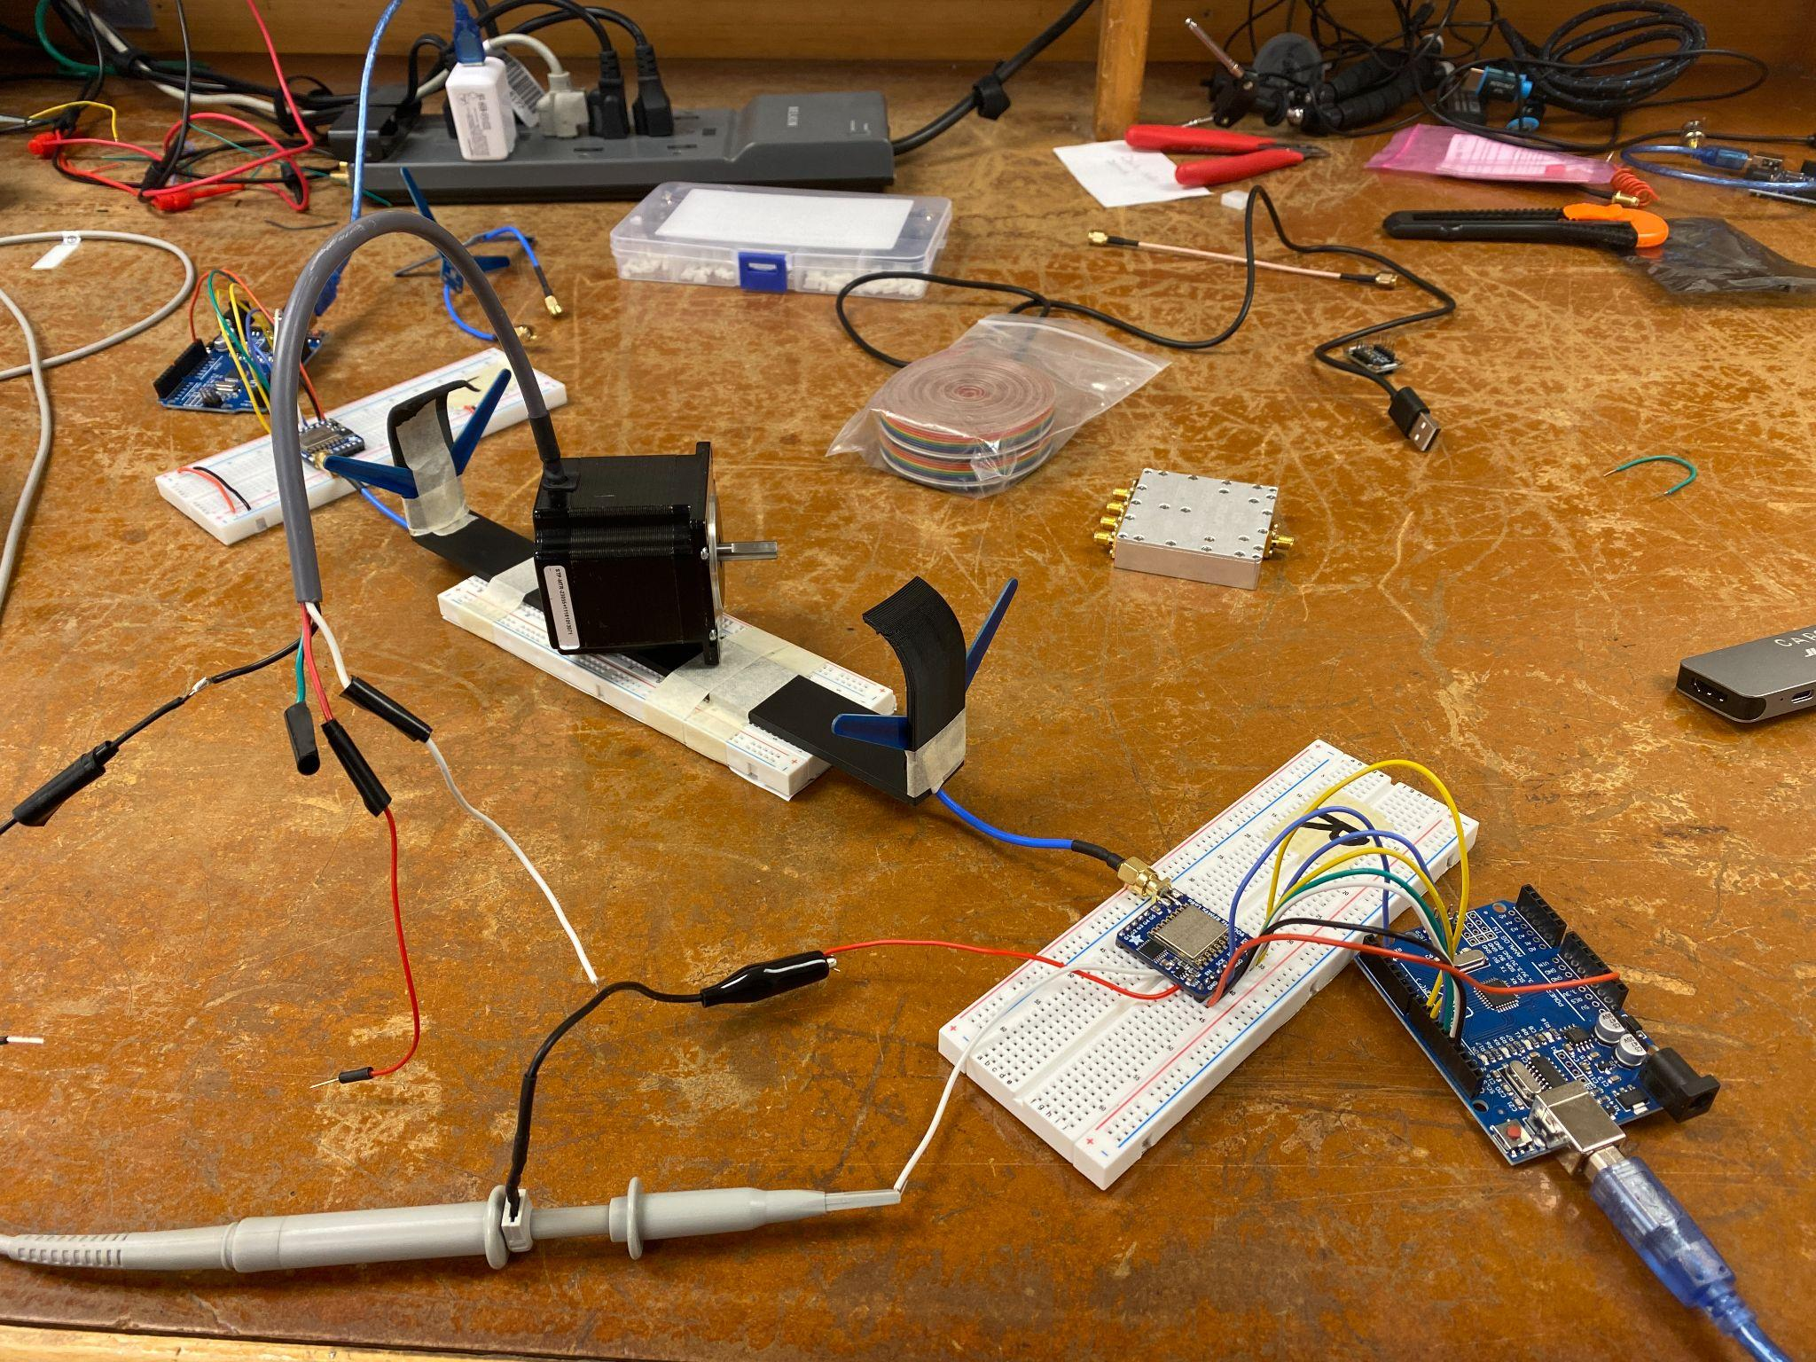
Design History/Impact of Tests (Hardware)
Notes:
Ahmed

Slide 25
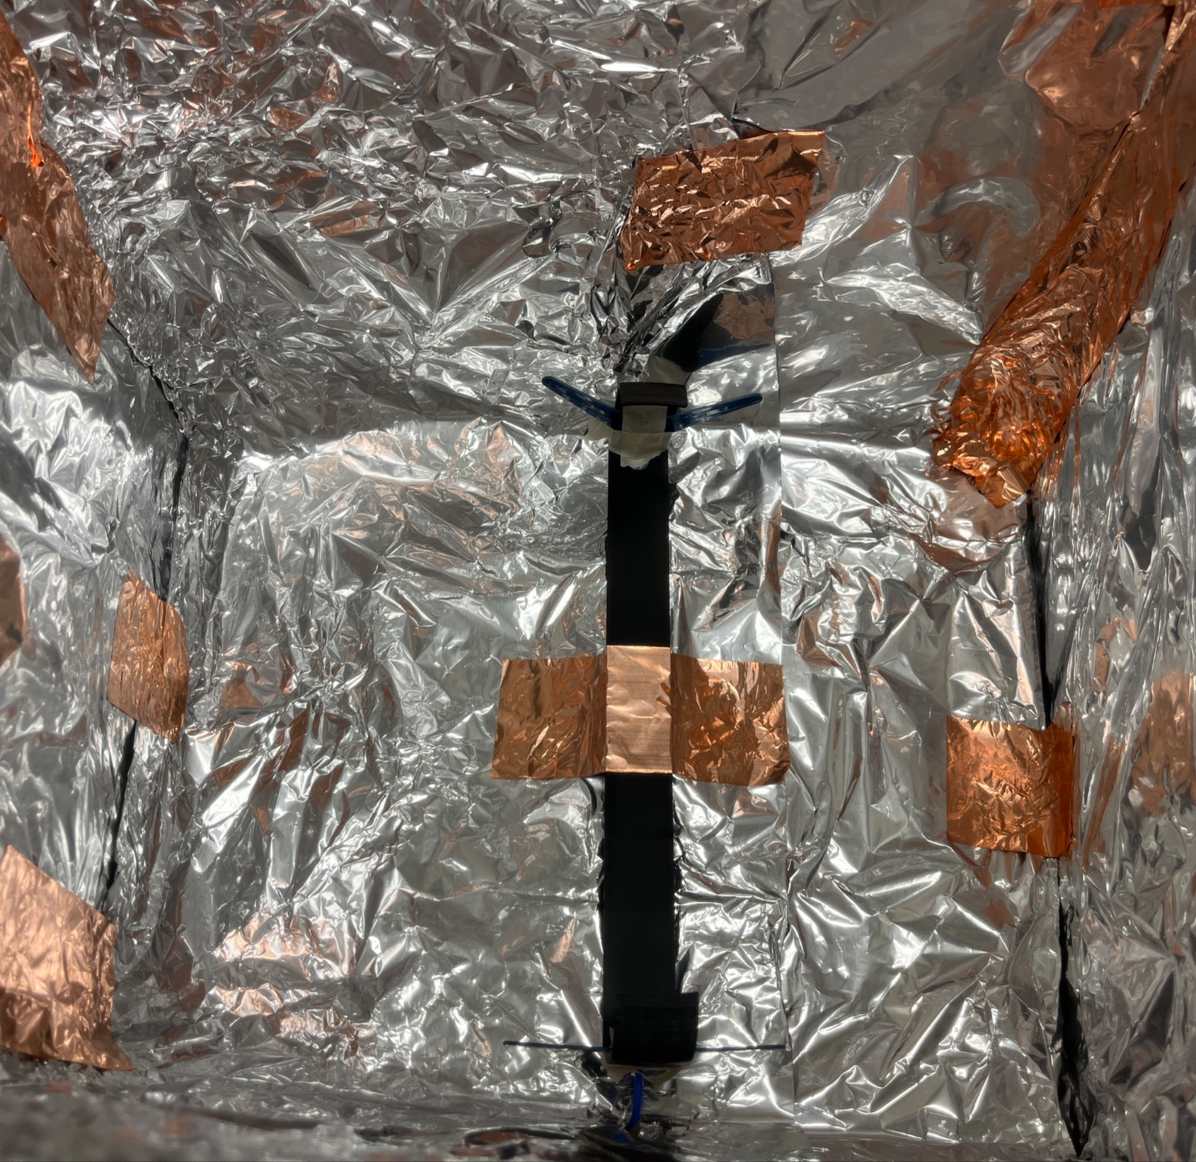
Important Research Progress
Project is research based, and many underlying tests were performed including:
Faraday Cage: failed due to extreme reflections that would make the placed object “invisible” to receiver
Noise Issue: dBm data values would shift in different environments.
First did tests to notice data shifts were proportional
Then confirmed system followed space loss 1/r^2 rule: -6 dBm per doubled distance. ΔdB=20log10​(2)≈6dB.
More tests confirmed noise/data variations coming from physical object surroundings such as people moving.
Fast sampling code implemented to reduce movement variations
Notes:
Graham

Slide 26
Challenges Overcome
Primary challenge: scaling error at close ranges.
Reducing pyEIT sensor count to eight sensors.
Integrating sensors with hardware.
Getting LoRa modules to communicate with each other.
Reducing environmental noise disruption.
Figuring out which imaging algorithm to use.
Notes:
Gus

Slide 27
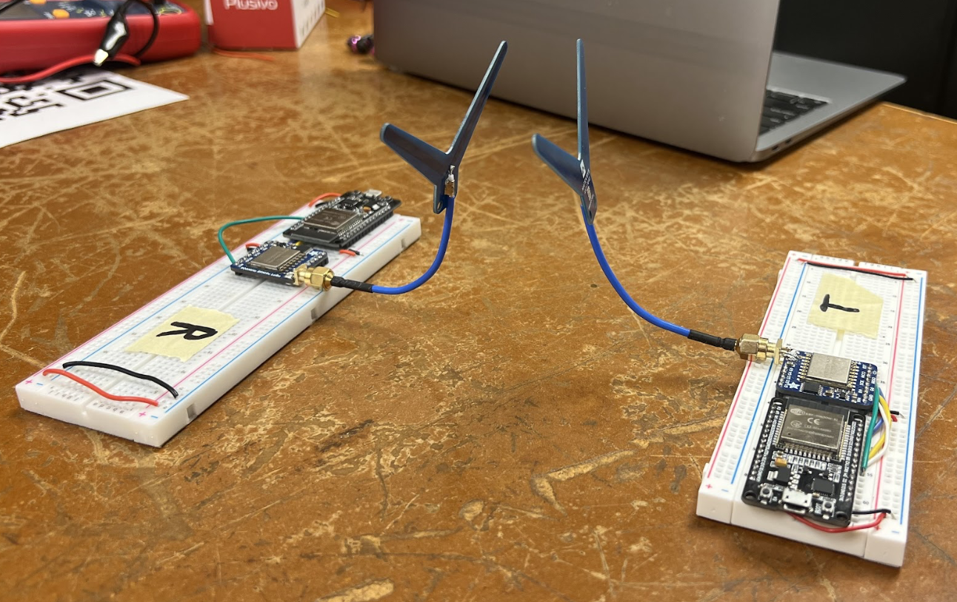
Accomplishments
Some accomplishments we are proud of include:
Getting LoRa PoC working.
Detecting differences in RF signal strength based on object between sensors.
Getting some basic pyEIT tests working.
Producing images using pyEIT and simulated data.
Working on this project made everyone learn lots about EIT/RF communication, such as:
Basic architecture/structure of a variety of imaging libraries.
LoRa sensor to Arduino interfacing.
Using LoRa modules to transmit and receive data and measure the RSSI.
Measured signal intensity changes due to objects in the path of the radio signal.
Notes:
Gus

Slide 28
Weekly Roadmap
Week 3 ~ Validate Faraday Cage Noise Reduction Strategy
Weeks 4 - 5 ~ Four Sensor Set up using RFM95
Week 6 ~ Integrate full pipeline with pyEIT
Week 7 ~ Minimize noise, plan strategies to maximize resolution
Week 8 - 12 ~ Eight sensor setup, implement plans from week 7
Week 12 - 14 ~ Debug, Test, optimize presentation, housing, work on stretch goals (UI, material classification)
Week 15 ~ Finalize EXPO presentation
Week 16 ~ Present at EXPO
Notes:
Dante

Slide 29
Budget
Total Allocated Amount: $1500
Amount Spent: ~ $724.36
Amount Remaining: ~ $775.64
Remaining costs:
Hardware enclosure: ~ $100
New Antennas: ~ $40
Custom PCB: Free (Or up to $150 with circular format)
Total Leftover: $485.64
No concerns about staying in budget. Leftover amount possibly used for noise insulation.
Notes:
Graham

Slide 30
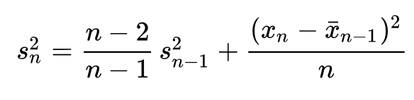
Cool Engineering Feature - Averaging Algorithm
Finding mean and standard deviation is computationally expensive
Calculating mean and variance scales with polynomial time naively
Using a modified version of Welford’s online algorithm, we can calculate the variance continuously in less than polynomial time
The mean is also calculated in a less-than-polynomial time manner
Notes:
Peter

Slide 31
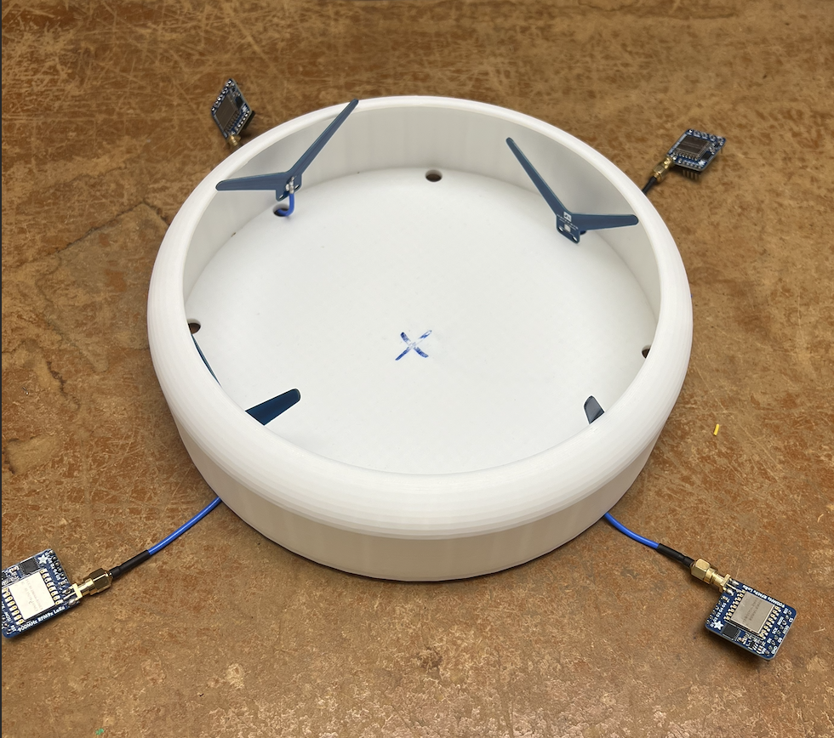
Summary
At Expo we will have an RF system which will image between three different material objects based on dielectric properties
Primary Achievements → system which distinguishes objects on dielectric properties and images simulated data
Primary concerns → Imaging software resolution based on limited dBm data range from LoRa sensors.
+
Notes:
Gavin

Slide 32
Questions?
Notes:
Dante

Slide 33
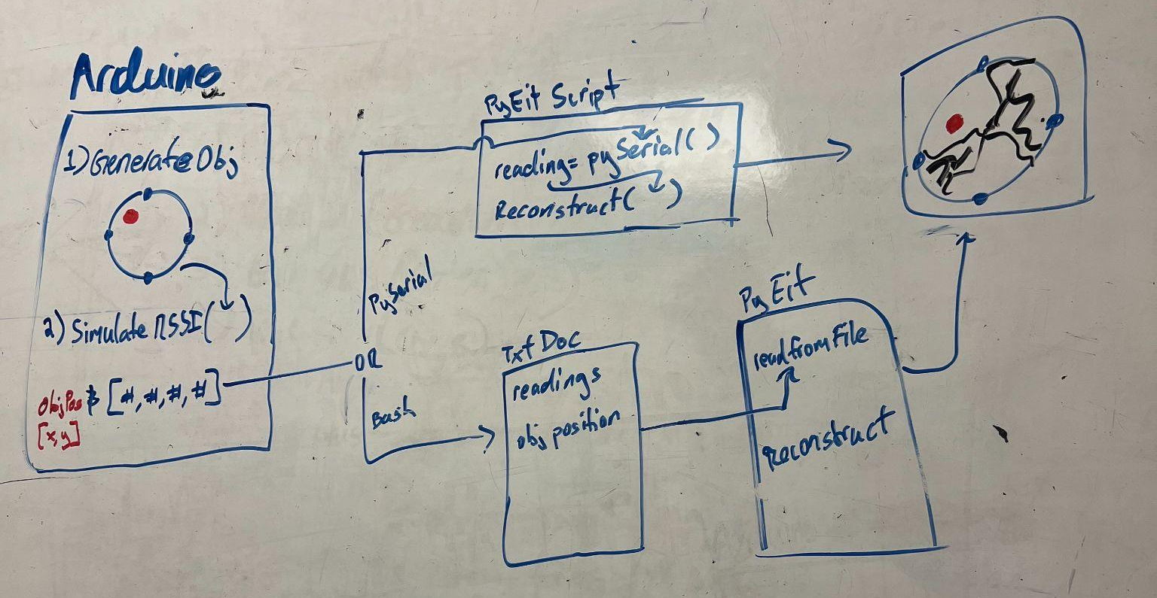
Auxiliary Slide 1

Slide 34
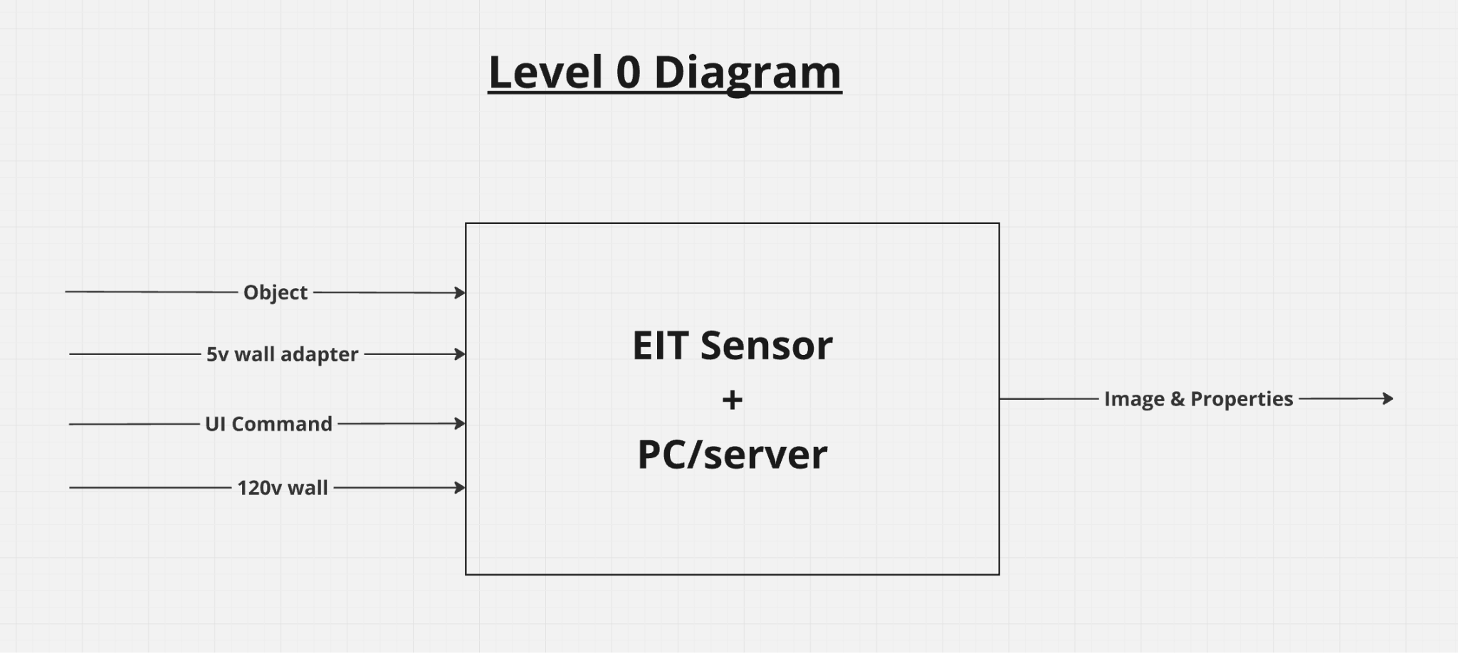
Auxiliary Slide 2

Slide 35
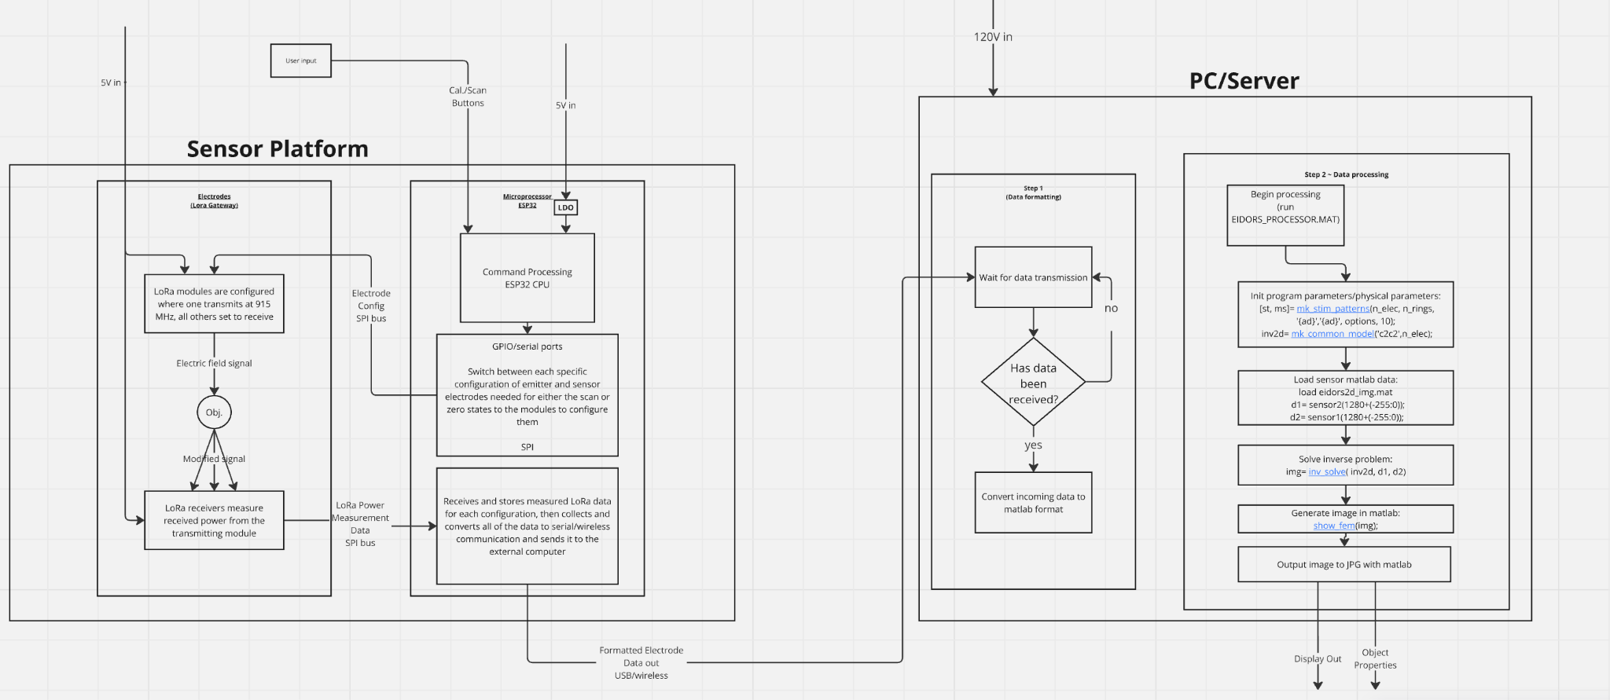
Auxiliary Slide 3: Level 2 Diagram

Slide 36
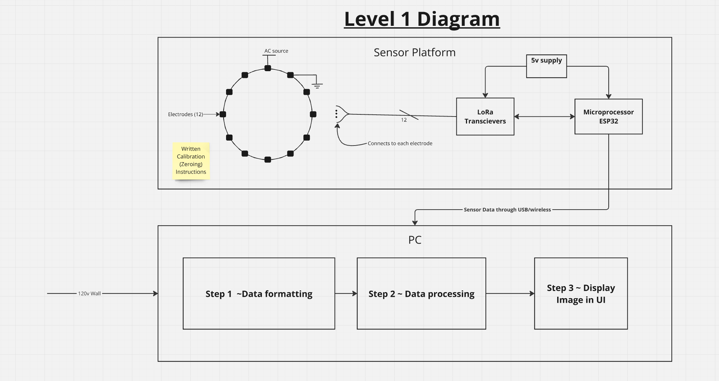
Auxiliary Slide 4: Level 1 Diagram

Slide 37
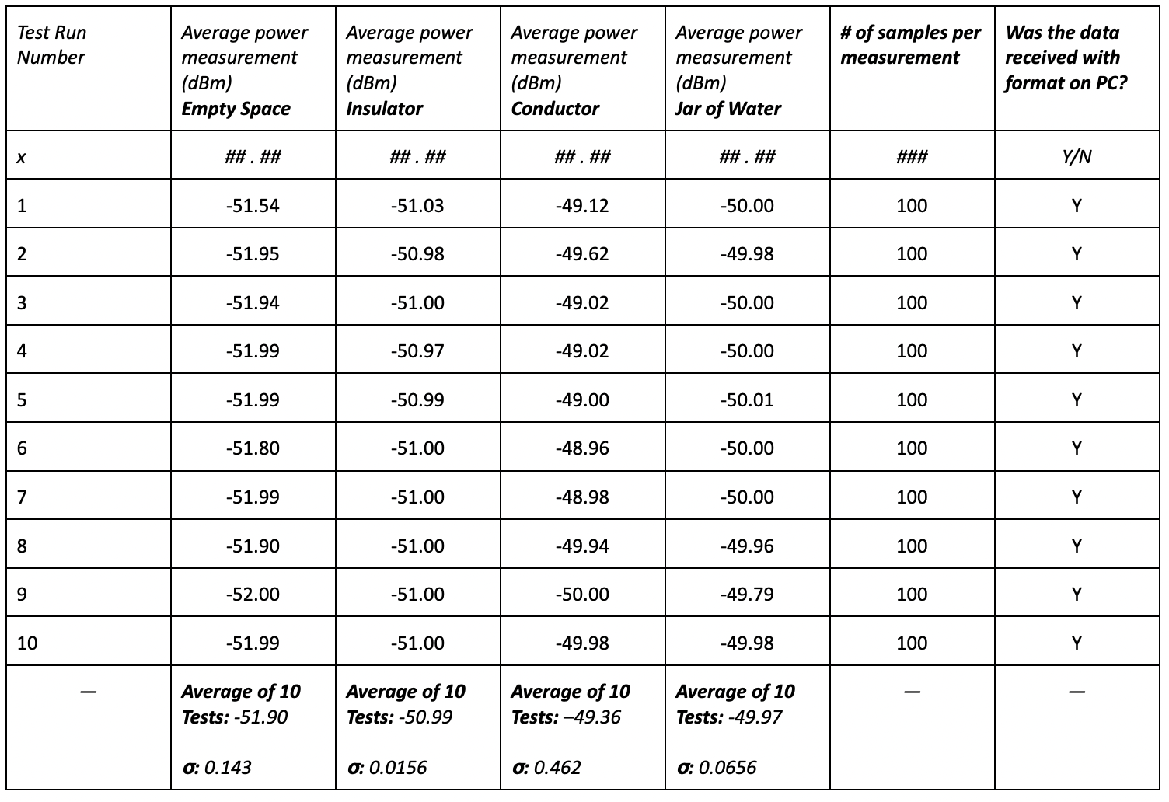
Auxiliary Slide 5: PoC Data

